Slide 1
CS161 Discussion 5 Adversarial Search: Games
Jinghao Zhao
11/06/2020

Slide 2
Game Search
Games:
Require making some decision when calculating the optimal decision is infeasible
Penalize inefficiency severely
How to choose a good move when time is limited?

Slide 3
Game Search
Pruning
Ignore portions of the search tree that make no difference to the final choice
Evaluation functions
approximate the true utility of a state without doing a complete search

Slide 4
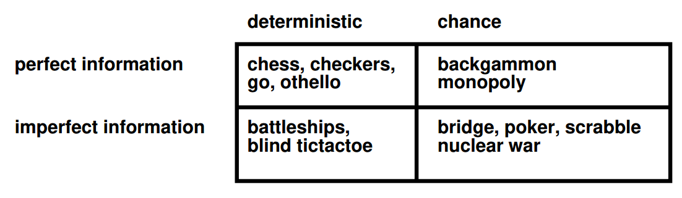
Types of Games

Slide 5
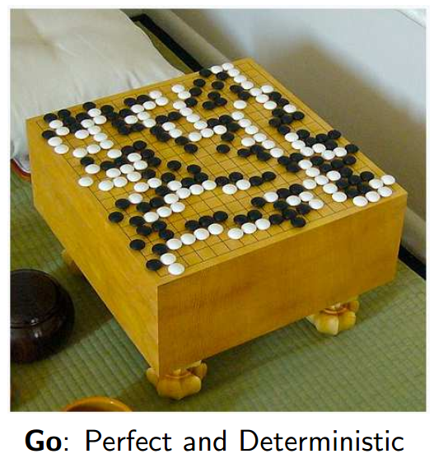
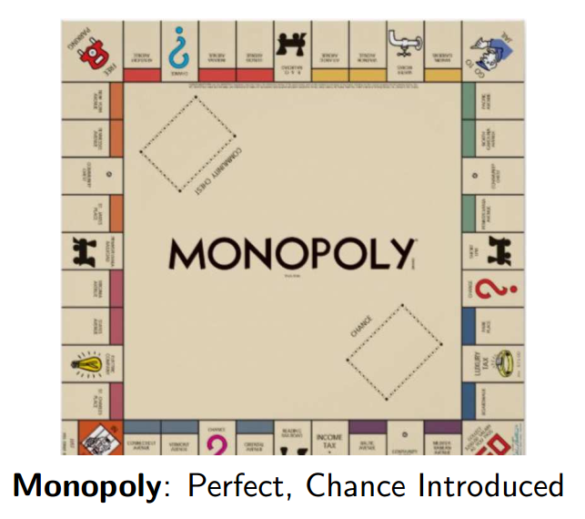
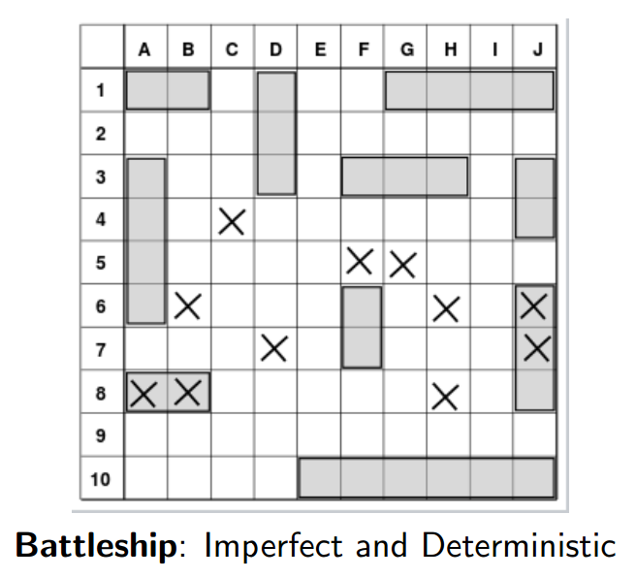
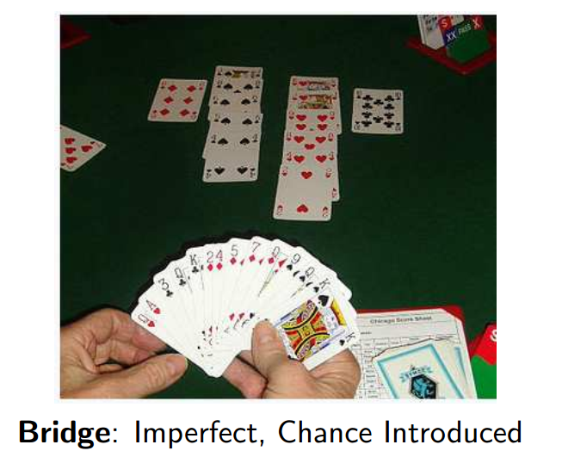
Types of Games

Slide 6
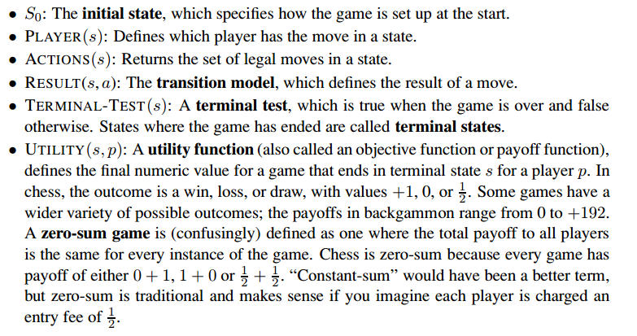
Games with Two Players

Slide 7
Optimal Decisions
What is an optimal solution in adversarial search?
Normal search:
a sequence of actions leading to a goal state
Adversarial search:
Find a contingent strategy
First move, moves in the states resulting from the other guy's possible moves, ...

Slide 8
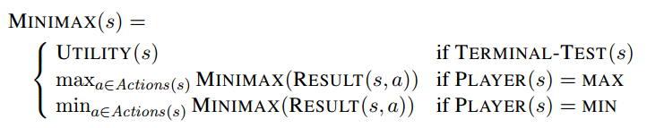
Optimal Decisions - MINIMAX
Given a game tree, how to determine the optimal strategy?
MINIMAX(n)
The utility (for MAX)
Assume both players play optimally from there to end of game
Given a choice, MAX prefers to move to a state of maximum value, whereas MIN prefers a state of minimum value.

Slide 9
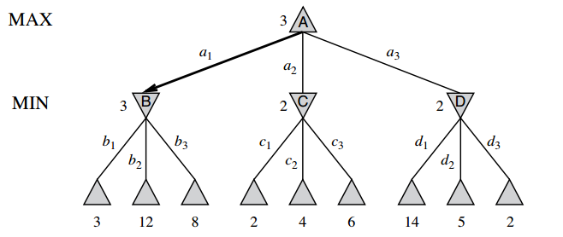
Optimal Decisions
Notes:
The terminal nodes on the bottom level get their utility values from the game’s UTILITY function. The first MIN node, labeled B, has three successor states with values 3, 12, and 8, so its minimax value is 3.

Slide 10
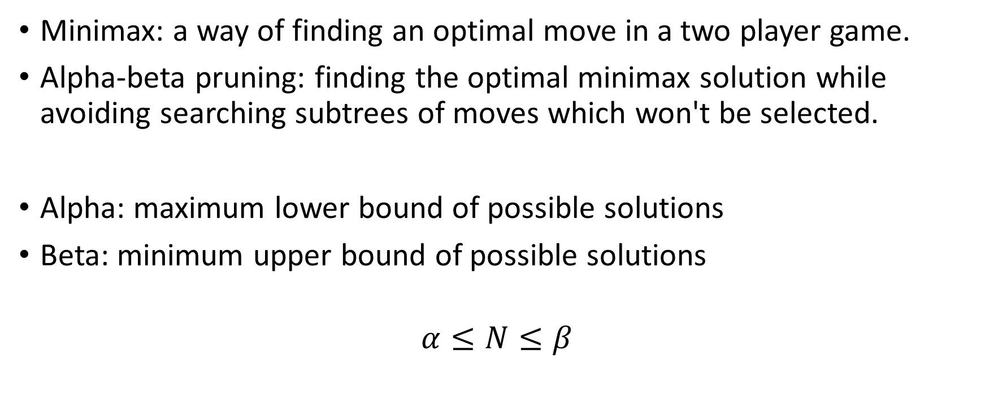
Alpha-beta pruning
Minimax: a way of finding an optimal move in a two player game.
Alpha-beta pruning: finding the optimal minimax solution while avoiding searching subtrees of moves which won't be selected.
Alpha: maximum lower bound of possible solutions
Beta: minimum upper bound of possible solutions
$$α≤N≤β$$
Notes:
N: estimated value of the node
http://web.cs.ucla.edu/~rosen/161/notes/alphabeta.html

Slide 11
Example
Notes:
The terminal nodes on the bottom level get their utility values from the game’s UTILITY function. The first MIN node, labeled B, has three successor states with values 3, 12, and 8, so its minimax value is 3.

Slide 12
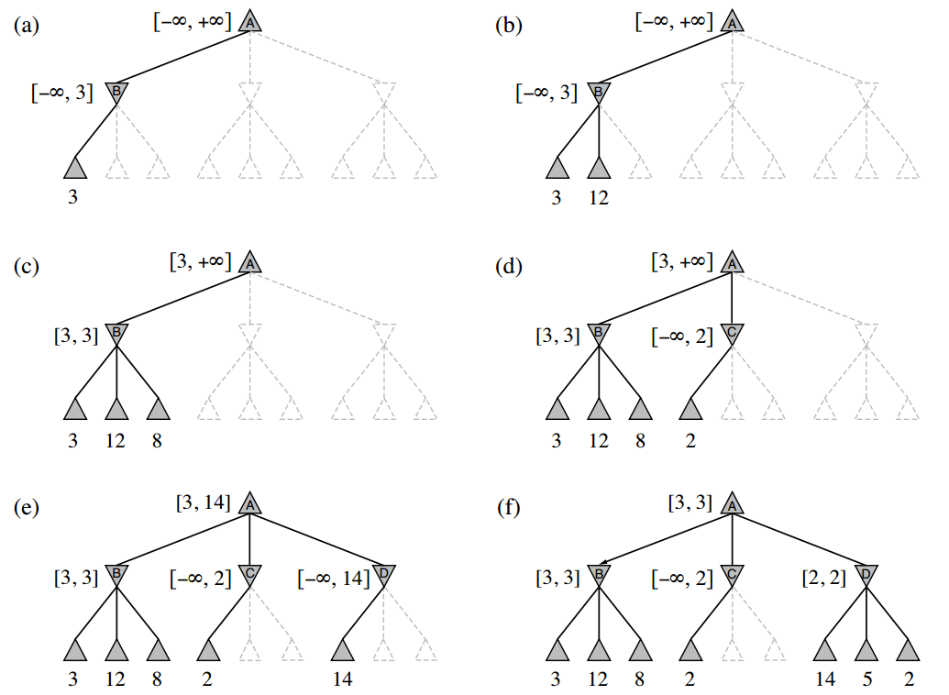
Alpha-beta pruning
Notes:
N: estimated value of the node
http://web.cs.ucla.edu/~rosen/161/notes/alphabeta.html

Slide 13
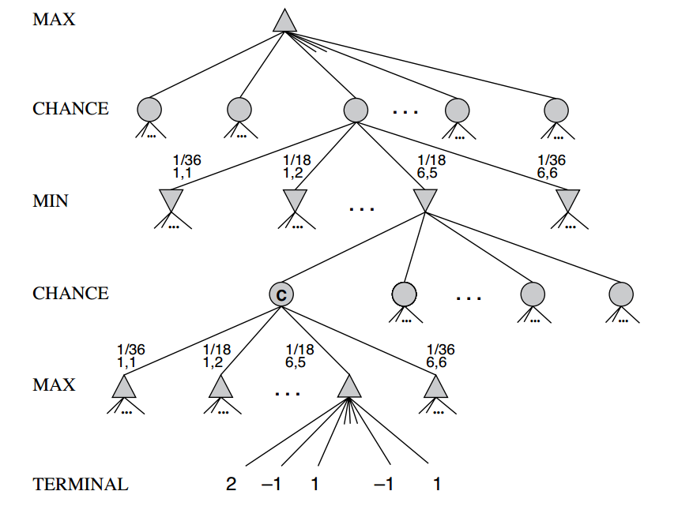
EXPECTMINIMAX

Slide 14
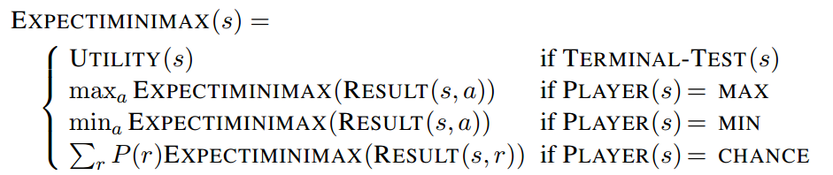
EXPECTMINIMAX

Slide 15
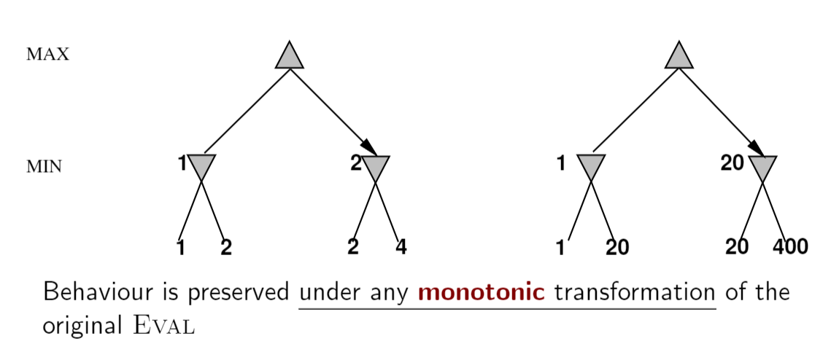
Transformation
In deterministic games, exact values do not matter.
In non-deterministic games, exact values matter!!!

Slide 16
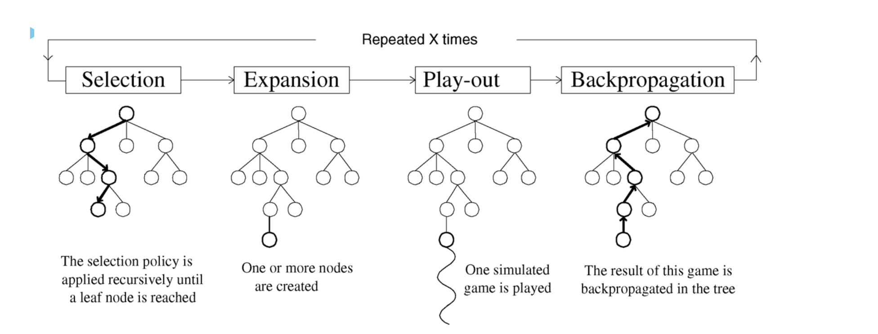
Monte Carlo Tree Search

Slide 17
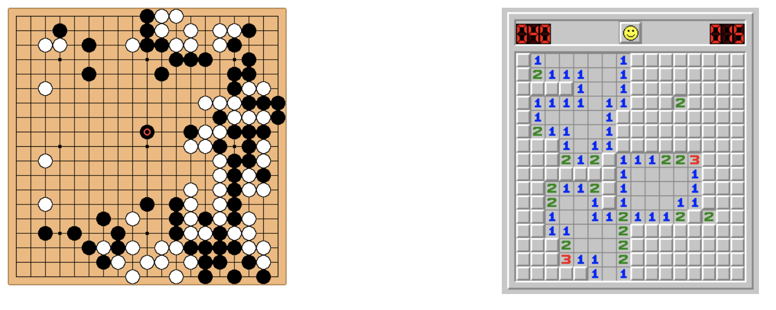
MCTS for computer Go and MineSweeper
Go: deterministic transitions
MineSweeper: probabilistic transitions

Slide 18
Basic Monte Carlo Simulation
No evaluation function?
simulate game using random moves
Score game at the end, keep winning statistics
Play move with best winning percentage
Repeat
Use this as the evaluation function, hopefully it will preserve some difference between a good position and a bad position

Slide 19
Monte Carlo Tree Search
MCTS builds a statistics tree (detailing value of nodes) that partially maps onto the entire game tree
Statistics tree guides the AI to focus on most interesting nodes in the game tree
Value of nodes determined by simulations

Slide 20
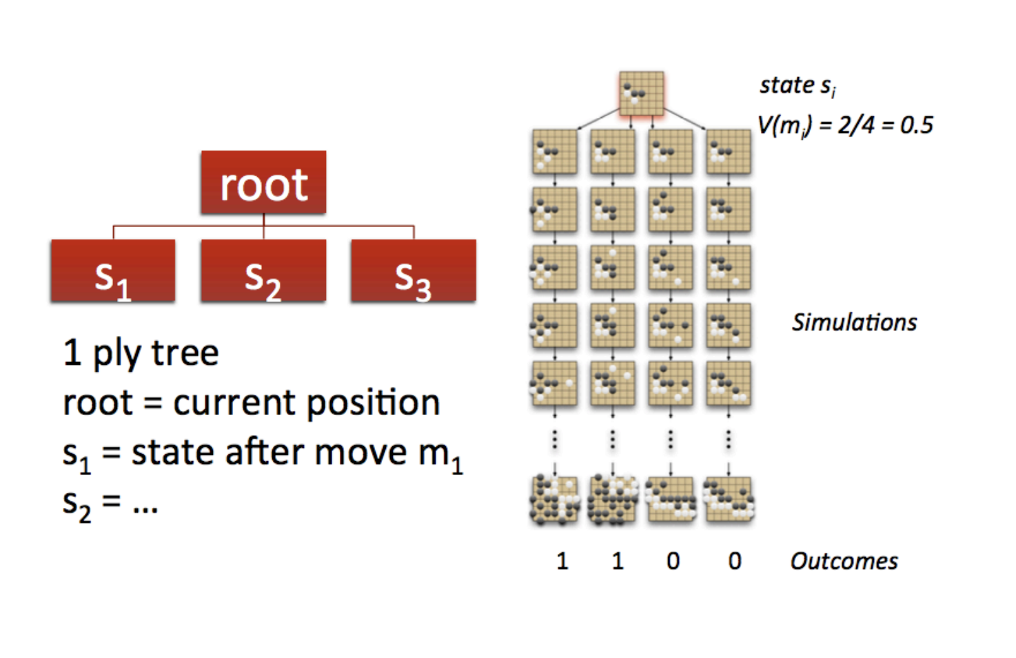
Basic Monte Carlo Search

Slide 21
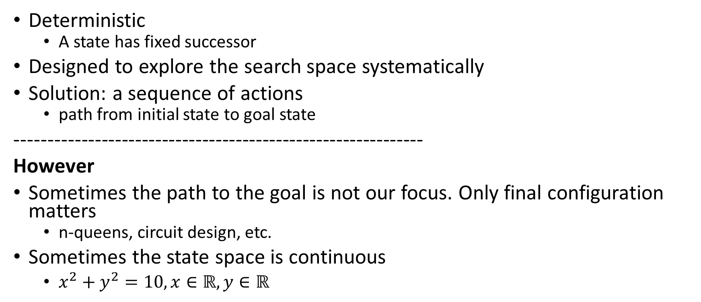
Classical Search
Deterministic
A state has fixed successor
Designed to explore the search space systematically
Solution: a sequence of actions
path from initial state to goal state
-------------------------------------------------------------
However
Sometimes the path to the goal is not our focus. Only final configuration matters
n-queens, circuit design, etc.
Sometimes the state space is continuous
$x^{2}+y^{2}=10, x∈ℝ, y∈ℝ$

Slide 22
Local Search
Keep track of a single node (current state)
Move to neighbors
No need to keep paths
Advantages:
Little memory
Find reasonable solution in large or infinite state spaces
Good for optimization problems (Find best state according to an objective function)

Slide 23
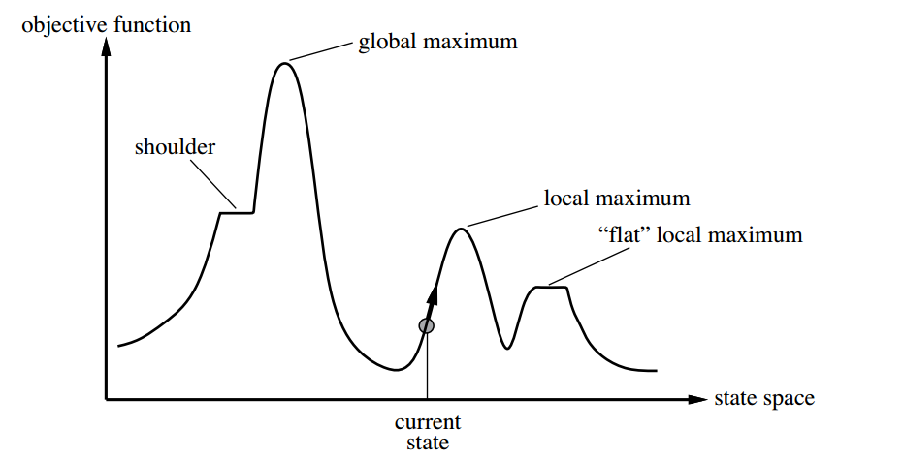
Example - State-Space Landscape
Notes:
state-space landscape

Slide 24
Hill-climbing search
Greedy local search
Grabs a good neighbor state without thinking ahead about where to go next.
Check all neighbors of current state
choose the one with the highest value (lowest cost)
Terminate when no neighbor has a higher value
Notes:
Hill climbing often makes rapid progress toward a solution because it is usually quite easy to improve a bad state.

Slide 25
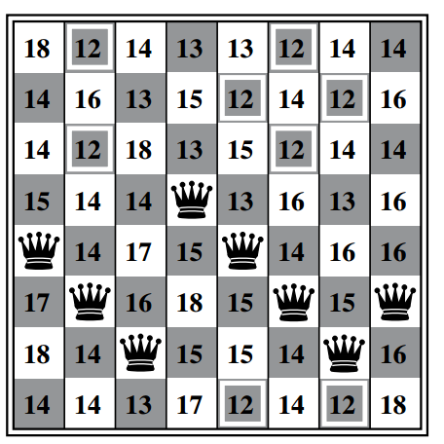
Example – 8-queens
Notes:
The heuristic cost function h is the number of pairs of queens that are attacking each other, either directly or indirectly

Slide 26
Hill-climbing search
Advantage
Easy to improve a bad state (rapid progress)
Disadvantage
Get stuck in
local optimal
Ridges
Plateau
Notes:
Hill climbing often makes rapid progress toward a solution because it is usually quite easy to improve a bad state.

Slide 27
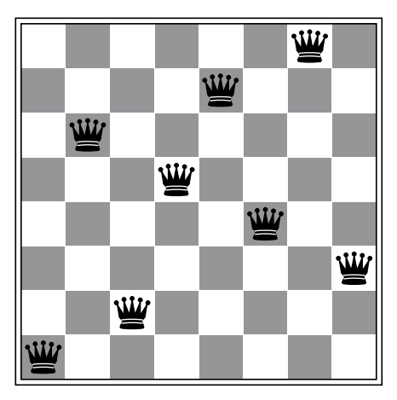
Example – 8-queens
The state has h = 1 but every successor has a higher cost.

Slide 28
Hill-climbing search
Disadvantage
Get stuck in
local optimal
Ridges
Plateau
The success of hill climbing depends very much on the shape of the state-space landscape!
NP-hard problems typically have an exponential number of local maxima to get stuck on.
Notes:
Hill climbing often makes rapid progress toward a solution because it is usually quite easy to improve a bad state.

Slide 29
Simulated Annealing
Hill-climbing algorithms never move towards state with lower value
May result in local optimal
Simulated Annealing: an analogy of metropolis methods
Randomly select candidate successor
Go there if better
Else go there with probability (Why?) function of “energy” and “temperature”

Slide 30
Local Beam Search and Stochastic Beam Search
Local Beam Search
Start with k states
Keep the best k successors
Advantage: useful information is passed among the parallel search
Disadvantage: lack of diversity
What if all the k successors get stuck at the same local optimal?
Stochastic Beam Search
(Introducing randomness)
Randomly select k successors
Better successor has a higher chance to be selected

